Slide 1
Chapter 6
Requirements Discovery

Slide 2
Definitions
System Requirement
  something that the information system must do or a property that it must have
Requirements Discovery
  techniques to be used to identify system problems and solution requirements from the user community

Slide 3
Relative Cost to Fix an Error
Phase in which error found Cost Ratio
Requirement 1
Design 3 - 6
Coding 10
Development Testing 15 - 40
Acceptance Testing 30 - 70
Operation 40 - 1000

Slide 4
Requirements Definition Goal
Consistent
Complete
Feasible
Required
Accurate
Traceable
Verifiable

Slide 5
Requirements Discovery Activities
1. Problem Discovery & Analysis
2. Requirements Discovery
3. Documenting & Analyzing Requirements
4. Requirements Management

Slide 6
1. Problem Discovery & Analysis
Ishikawa Diagram
a graphical tool used to identify, explore, and depict problems and the causes and effects of those problems
4 Ms 4 Ps 4 Ss
Materials Places Surroundings
Machines Procedures Suppliers
Manpower Policies Systems
Methods People Skills

Slide 7
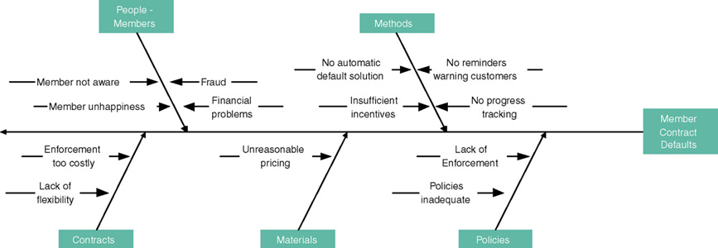
Ishikawa Diagram

Slide 8
2. Requirements Discovery
Fact-Finding
  the formal process of using research, interviews, questionnaires, sampling, and other techniques to collect information about problems, requirements, and preferences
Ethics
  confidential personal and sensitive corporate information is often revealed to the analyst during information gathering

Slide 9
3. Documenting and Analyzing Requirements
Documenting
  Use Cases
  Decision Tables
  Requirements Tables
Analyzing
  Missing, conflicting, infeasible, overlapping, and ambiguous requirements

Slide 10
cont’d ...
Formalizing Requirements
  Requirements Definition Document
    Functional & Non-functional requirements
    Constraints
    Interfacing information
  Requirements Validation
    Errors, conflicts, ambiguity and non-conformance to quality standards

Slide 11
Requirements must be …
Consistent
  not conflicting or ambiguous
Complete
  describe all possible system inputs and responses
Feasible
  can be satisfied based on the available resources and constraints
Required
  truly needed and fulfill the purpose of the system
Accurate
  stated correctly
Traceable
  directly map to functions and features of system
Verifiable
  defined so can be demonstrated during testing

Slide 12
Types of Requirements
Functional Requirement
  something the information system must do
Non-functional Requirement
  A property or quality the system must have
  Performance
  Security
  Costs

Slide 13
4. Requirements Management
Managing change by specifying how a change:
  should be submitted
  is analyzed
  is approved or rejected
  is implemented

Slide 14
Fact-Finding Techniques
1. Sampling
2. Research
3. Observation
4. Questionnaires
5. Interviews
6. Discovery Prototyping
7. Joint Requirements Planning

Slide 15
1. Sampling
Existing documentation, including:
  Memos, studies, minutes, notes, complaints, etc.
  Accounting records and reports
  Information systems project requests
  Standard operating procedures
  Flowcharts, manuals and documentation

Slide 16
Sampling Techniques
Sampling
  the process of collecting a representative sample of documents, forms, and records
Randomization
  a sampling technique with no predetermined pattern for selecting sample data
Stratification
  a systematic sampling technique that selects sample data by formula

Slide 17
2. Research
Don’t re-invent the wheel … look at:
  Other organizations
  Professional societies
  Trade publications
  Reference books
  Internet sites

Slide 18
3. Observation
Advantages
  a picture is worth a thousand words
  can be highly reliable
  can be measured
  inexpensive
Disadvantages
  observation can alter behavior
  events being observed may not be typical
  may be observing incorrect way of doing things

Slide 19
Observation Guidelines
Determine the who, what, where, when, why, and how of the observation
Obtain permission from appropriate supervisors
Inform those who will be observed of the purpose of the observation
Keep a low profile
Take notes
Review observation notes with appropriate individuals
Don't interrupt the individuals at work
Don't focus heavily on trivial activities
Don't make assumptions

Slide 20
4. Questionnaires
Advantages
  can be taken & analyzed quickly
  inexpensive for large data pool
  anonymous and convenient for respondent
Disadvantages
  low response rate
  incomplete
  inflexible
  cannot observe body language
  difficult to prepare

Slide 21
Types of Questionnaires
Free-format
  Greater latitude
Fixed-format
  Multiple-choice
  Rating
  Ranking

Slide 22
Fixed-format Questionnaires
Rank the following transactions according to the amount of time you spend processing them.
___ % new customer orders
___ % order cancellations
___ % order modifications
___ % payments
The implementation of quality discounts would cause an increase in customer orders.
___ Strongly agree
___ Agree
___ No opinion
___ Disagree
___ Strongly disagree
Is the current accounts receivable report that you receive useful?
___ Yes
___ No

Slide 23
5. Interviews
Advantages
  can motivate by establishing rapport
  can obtain feedback
  can reword questions for interviewee
  can observe body language
Disadvantages
  is very time-consuming
  is dependent on interviewer human relations skills
  may be impractical due to interviewee location

Slide 24
Types of Interviews
Unstructured Interview
  are conducted with only a general goal or subject with few specific questions
Structured Interview
  ask specific set of questions

Slide 25
Techniques
Open-ended Questions
  allow interviewee to respond in any way that seems appropriate
Closed-ended Questions
  restrict answers to specific choices or short, direct responses

Slide 26
Body Language & Proxemics
Body language
the nonverbal information we communicate
  Facial disclosure
  Eye contact
  Posture
Proxemics
the relationship between people and the space around them
  Intimate zone — closer than 1.5 feet
  Personal zone — from 1.5 feet to 4 feet
  Social zone — from 4 feet to 12 feet
  Public zone — beyond 12 feet

Slide 27
6. Discovery Prototyping
Definition
  building a small-scale working model of user’s requirements to verify those requirements
Advantages
  permits experimentation
  can determine feasibility prior to high cost
  serves as user training mechanism
Disadvantages
  developers need training for prototype approach
  users may develop unrealistic expectations
  may increase development time and costs

Slide 28
7. Joint Requirements Planning
Definition of JRP
  a process of conducting highly structured meetings to analyze problems and define requirements
Participants
  Sponsor Scribe
  Facilitator IT Staff
  Users & Managers

Slide 29
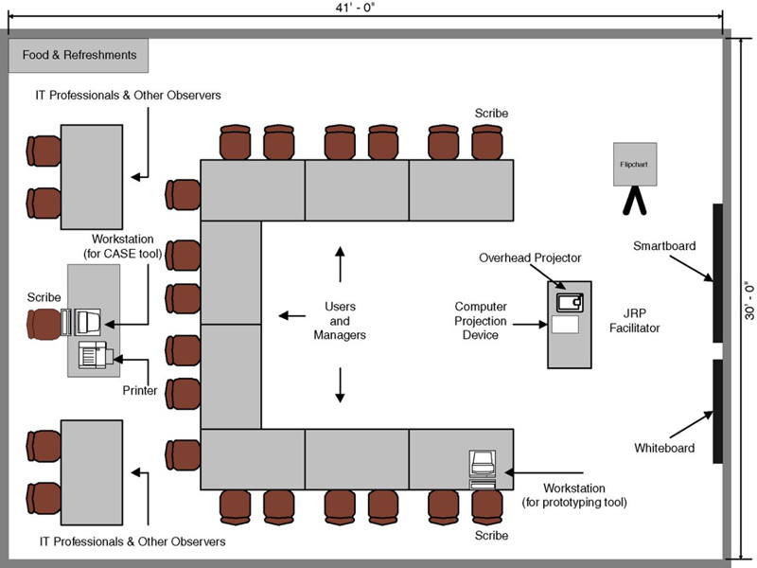
JRP Room Layout

Slide 30
Brainstorming
Sometimes, one of the goals of a JRP session is to generate possible ideas to solve a problem. Brainstorming, a technique for generating ideas by encouraging participants to offer as many ideas as possible in a short period of time, without any analysis, until all the ideas have been exhausted.

